Slide 1
Armory 101 - Basics
Presented by
Yehuda ben Moshe
Elmet Herald

Slide 2
Introduction
Armory is vast
Dozens of lines of division
Hundreds (thousands?) of charges
Postures of quadrupeds, birds, etc.
We cover only a tiny fraction of this
Many resources for learning more

Slide 3
Resources
SCA Heraldic Primer: http://heraldry.sca.org/armory/primer/
A Grammar of Blazonry: http://heraldry.sca.org/armory/bruce.html
Articles: http://heraldry.sca.org/armory_articles.html
Parker’s Glossary: http://www.heraldsnet.org/saitou/parker/Jpglossa.htm

Slide 4
Resources
Arthur Charles Fox-Davies - A Complete Guide To Heraldry
http://archive.org/details/completeguidetoh00foxdrich
John Woodward - A Treatise on Heraldry, British and Foreign
Rodney Dennys - The Heraldic Imagination

Slide 5
Resources
Period rolls of arms:
http://www.s-gabriel.org/heraldry/
http://www.vikinganswerlady.com/Stars/Rolls_of_Arms.html
http://www.yehudaheraldry.com/rolls

Slide 6
Terminology
Emblazon
The actual drawing of the device
Blazon A verbal description of the device
Written in a special language derived from Norman French
Follows specific grammar and construction rules
Not important to get right on a submission
We register the picture (emblazon), not the words (blazon)

Slide 7

Terminology
Directions are from the point of view of the person holding the shield
Chief
Dexter
Sinister
Base

Slide 8
Terminology
Field – base “layer” of the device
Lines of division
Charges – anything placed on the field (or on top of other charges)
Tinctures
Colors
Metals

Slide 9
Rules
SENA
Standards for Evaluation of Names and Armory
Found at: http://heraldry.sca.org/laurel/sena.html
Current rules for all submissions
Broken into 4 main sections:
General Principles
Personal Names
Non-Personal Names
Armory
Includes 13 appendices

Slide 10
Rules - Basics
Reproducibility (A1C)
Given a written blazon, two different artists should be able to draw very similar emblazons of the armory
Armory must be describable in standard heraldic terms

Slide 11
Rules - Basics
Recognizability (A1D)
Armor should lend itself to instant identification
Most of the period heraldic rules and styles arose out of this need
The viewer should be able to immediately identify the charges and arrangements

Slide 12
Rules - Basics
Submissions should be reasonably period (GP1B1)
Period elements
Period combinations of the elements
“Core style” defines most common elements and combinations
Individually attested patterns allow submissions outside core style

Slide 13
Rules - Basics
Core Style (A1A1)
Described in detail in A2 and A3
Not identical to the style of any specific place and time
Based on the Anglo-Norman style
For the most part, doesn’t require documentation

Slide 14
Rules - Basics
Individually Attested Patterns (A1A2)
Armory that doesn’t meet “Core Style” requirements
Registerable if adequately documented
Described in detail in A4

Slide 15

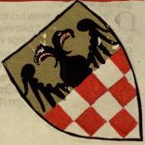
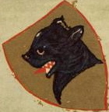
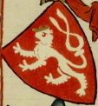
Evolution of Heraldry
Early devices were simple, designed for rapid identification of opponents.
Images from the Manesse Codex ca 1305

Slide 16
Evolution of Heraldry
As warfare and technology evolved, individual identification became less important
“Heraldic space” was filling up
Heraldry became a perk of the nobility
Devices got more complex

Slide 17
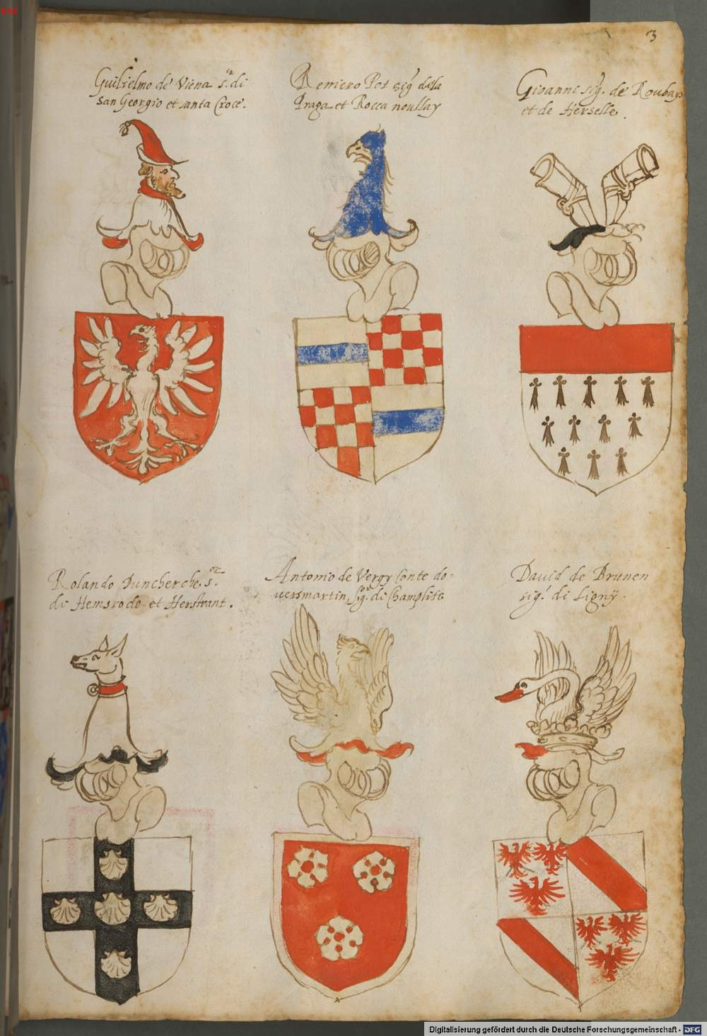
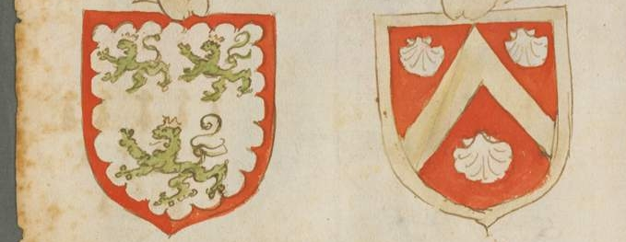
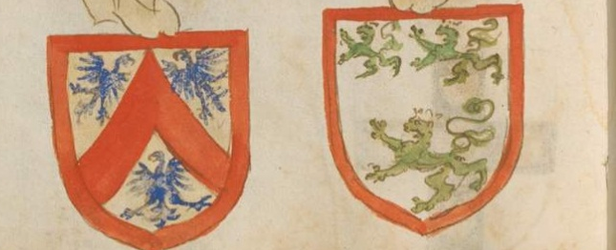
Evolution of Heraldry
Images from the Armorial of the Order of the Golden Fleece ca 1560

Slide 18
Evolution of Heraldry - Marshalling
Noble families combined arms to show relationships
Armigerous wives combined their devices with those of their husbands
Children with two armigerous parents used devices combining those of
Three types of marshalling – dimidiation, impalement, quartering

Slide 19
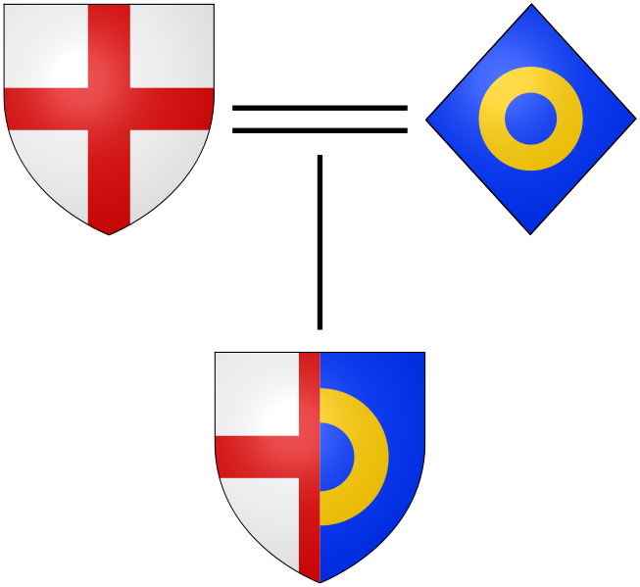
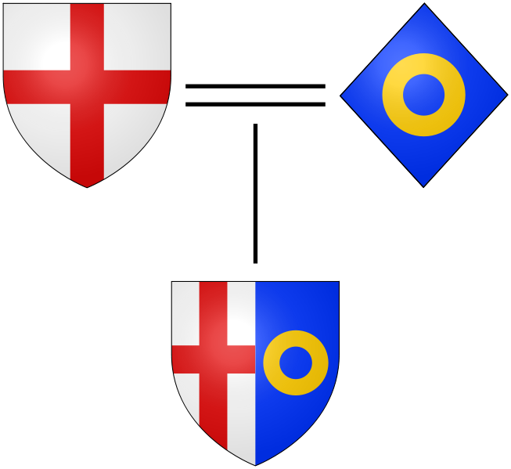
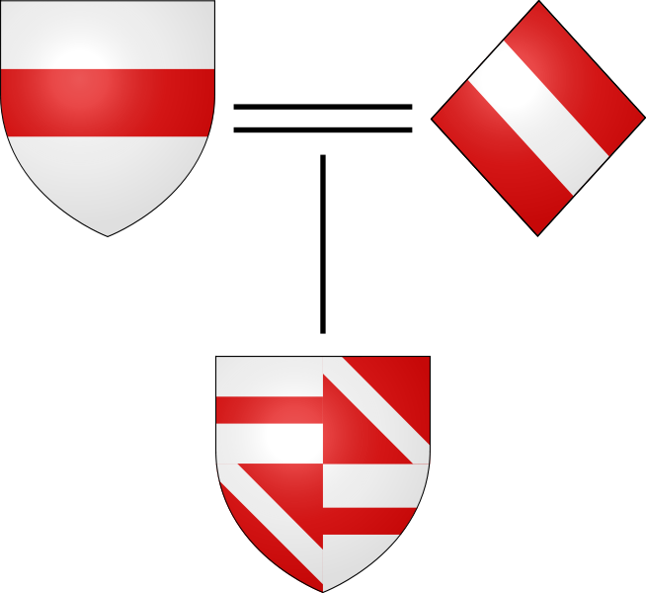
Evolution of Heraldry - Marshalling
Dimidiation
Impaling
Quartering
Images from Wikimedia Commons

Slide 20
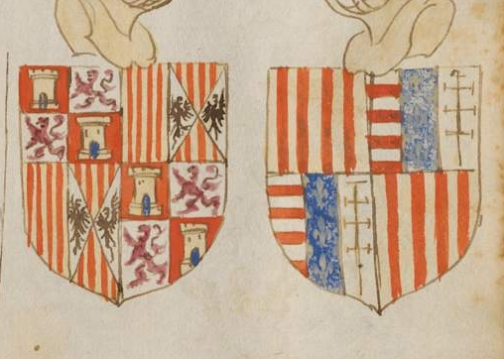
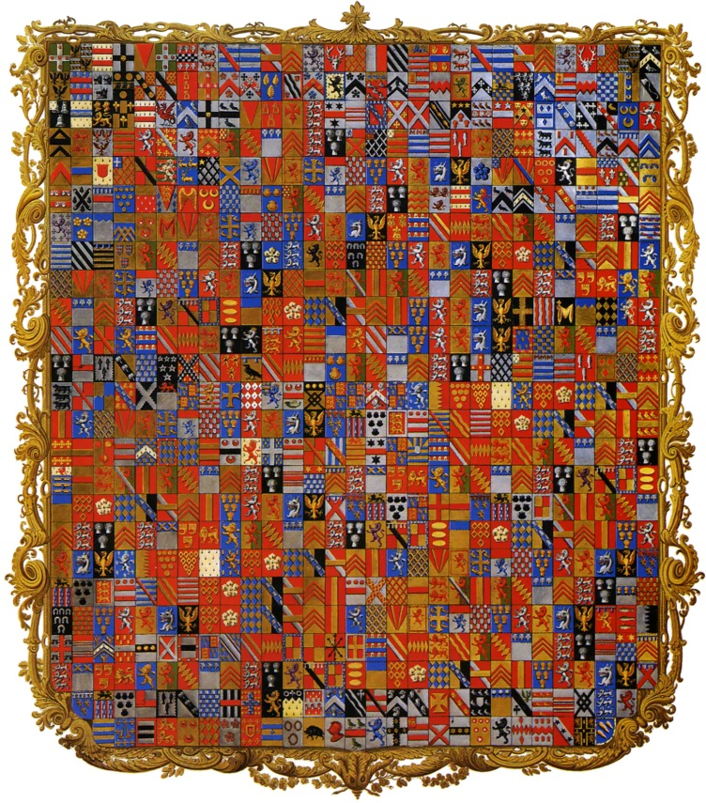
Evolution of Heraldry - Marshalling

Slide 21
Tinctures (A3B1)
Colors
Gules
Azure
Sable
Vert
Purpure
Metals
Or
Argent

Slide 22






Tinctures (A3B1)
Metals
Colors
Ermine
Erminois
Counter-
Ermine
Pean
Neutral
Vair
Potent

Slide 23
Ordinaries
Ordinaries are charges
They are usually comprised of simple geometric figures running from side to side or top to bottom of the field
Ordinaries can be classified as central or peripheral

Slide 24




Ordinaries
Central Ordinaries
a Pale
a Fess
a Bend
a Bend
Sinister

Slide 25

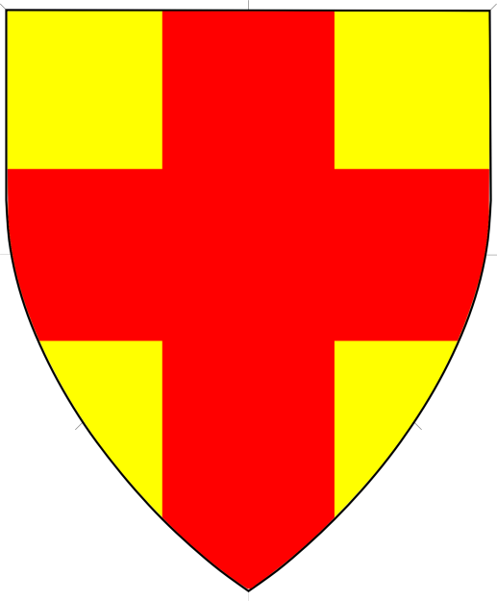
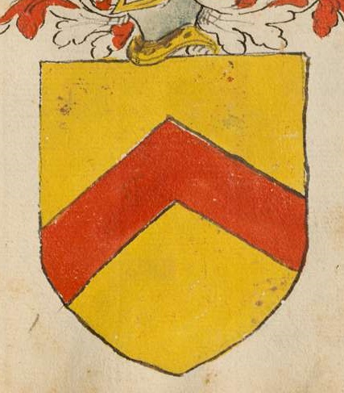

Ordinaries
Central Ordinaries
a Saltire
a Cross
a Chevron
a Chevron Inverted

Slide 26


Ordinaries
Central Ordinaries
a Pall
a Pall Inverted

Slide 27



Ordinaries
Peripheral Ordinaries
Chief
Base
Bordure

Slide 28
Lines of Division
Divides the field into 2 or more sections
Also known as:
“Lines of Partition”
“Field Divisions”
“Field Partitions”

Slide 29




Lines of Division
Divisions into 2 sections
Per Fess
Per Pale
Per Bend
Per Bend
Sinister

Slide 30


Lines of Division
Divisions into 2 sections
Per Chevron
Per Chevron Inverted

Slide 31
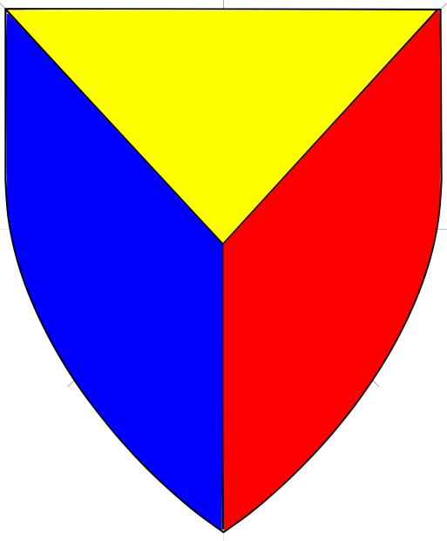
Lines of Division
Division into 3 sections
Per Pall

Slide 32


Lines of Division
Divisions into 4 sections
Per Saltire
Quarterly

Slide 33
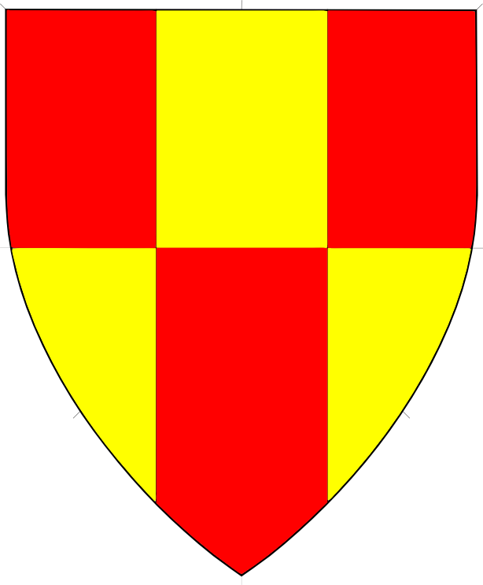
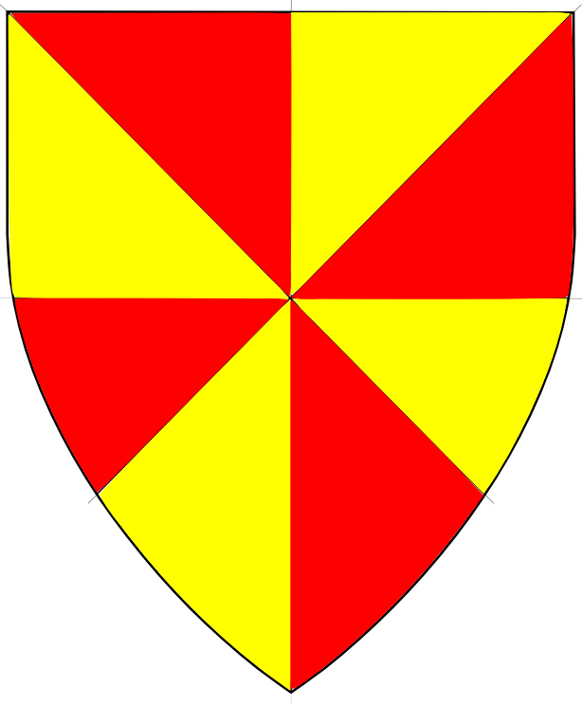
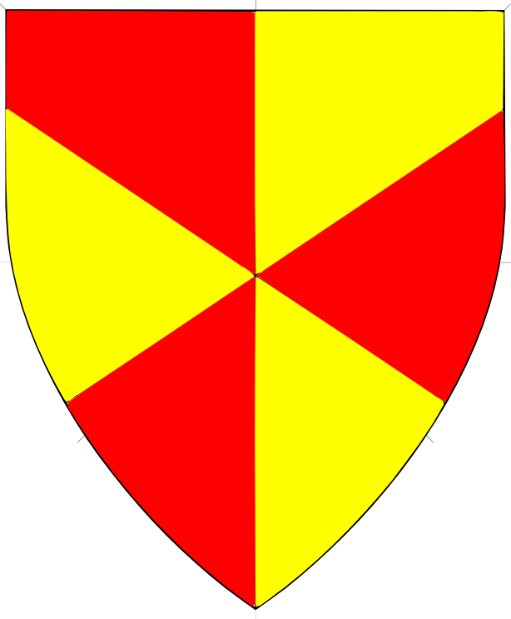
Lines of Division
Divisions into 6 or more sections
Party of Six
Gyronny of Eight
Gyronny of Six

Slide 34




Charges
Geometrics
Roundels
Mullets
(of five points)
Annulets
a Pile

Slide 35




Charges
Animals
Lion Rampant
Peacock in its Pride
Eagle Displayed
Dragon Segreant

Slide 36
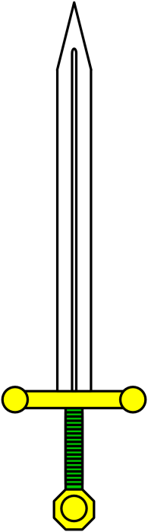
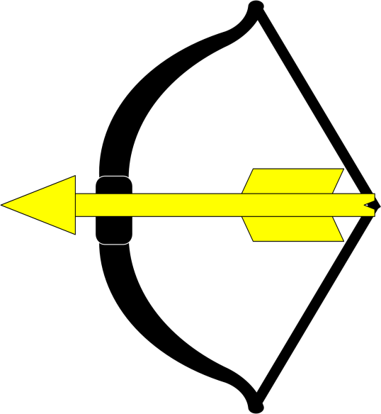


Charges
Other
Bow and Arrow
Sword
Fleur de Lys
Ermine Spot

Slide 37
Complex Lines
Lines of division and lines forming ordinaries shown so far were simple, straight lines
Such lines can also be complex, using various patterns.

Slide 38




Complex Lines
Embattled
Indented
Wavy
Rayonny
Images from Wikimedia Commons

Slide 39




Complex Lines
Invected
Engrailed
Nebuly
Urdy
Images from Wikimedia Commons

Slide 40
Rules of Heraldry – Blazon
Blazon utilizes a specific grammar structure
Items generally follow the pattern “number, type, posture, tincture”, with tincture always the last
“Arrangement” can come before the “number” of after “posture”
We usually blazon from lowest to highest level, from center out, from chief to base, from dexter to sinister
Field is always blazoned first

Slide 41
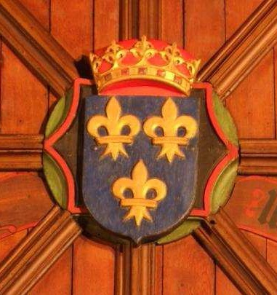
Rules of Heraldry – Blazon
Azure,
three fleurs-de-lys
Or.
Arms of France
Images from St. Machar’s Cathedral, Aberdeen, ca AD 1520
Notes:
No need to specify two-and-one – that’s the default for three.

Slide 42
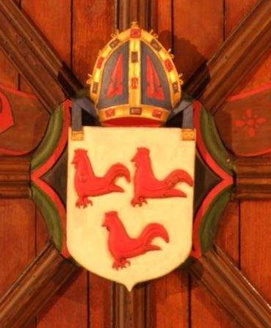
Rules of Heraldry – Blazon
Argent
three cocks
gules.
Arms of Robert Cockburn
Note the cant
Images from St. Machar’s Cathedral, Aberdeen, ca AD 1520

Slide 43
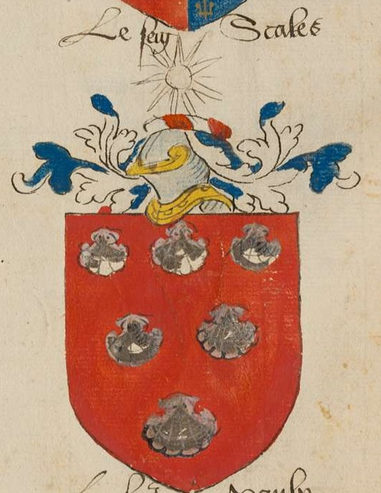
Rules of Heraldry – Blazon
Gules,
six escallops
three, two, and one
argent.
Images from Insignia Anglica, mid 16C
Notes:
Not sure if there’s a default for six items on the field.

Slide 44
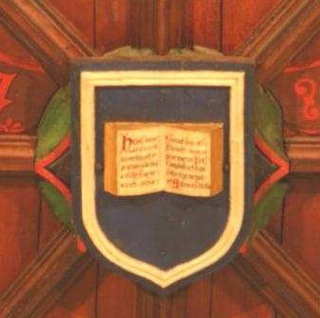
Rules of Heraldry – Blazon
Azure
an open book
within an orle
argent.
Arms of the King’s College of Aberdeen
Images from St. Machar’s Cathedral, Aberdeen, ca AD 1520

Slide 45
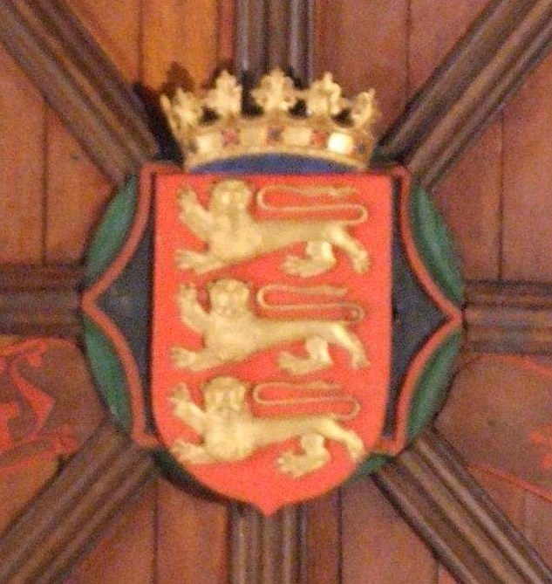
Rules of Heraldry – Blazon
Gules,
in pale
three lions
passant guardant
Or.
Arms of England
Images from St. Machar’s Cathedral, Aberdeen, ca AD 1520

Slide 46
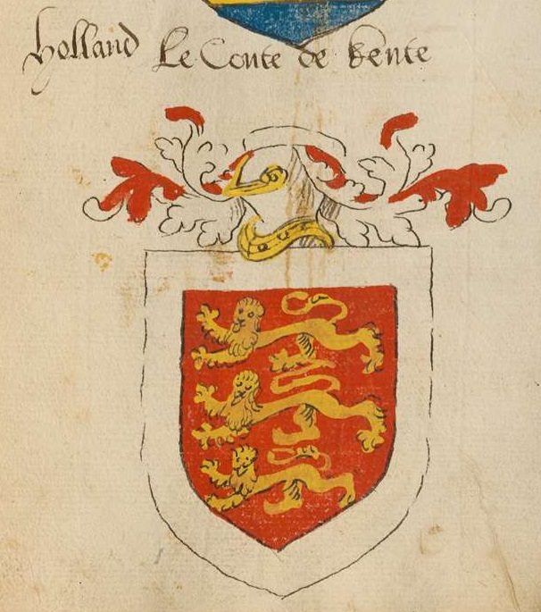
Rules of Heraldry – Blazon
Gules,
in pale
three lions
passant guardant
Or
within a bordure argent.
Thomas Holland, Earl of Kent
Images from Insignia Anglica, mid 16C

Slide 47
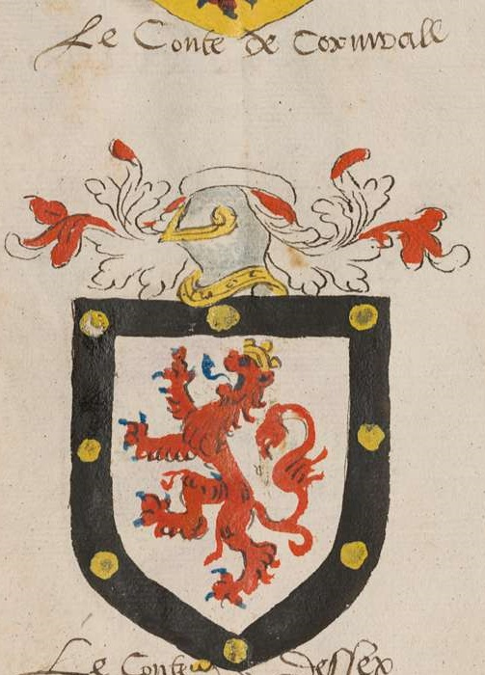
Rules of Heraldry – Blazon
Argent,
a lion gules,
a bordure
sable
semy of roundels
Or.
Count of Cornwall
Images from Insignia Anglica, mid 16C
Notes:
Roundels Or can be called bezants.

Slide 48
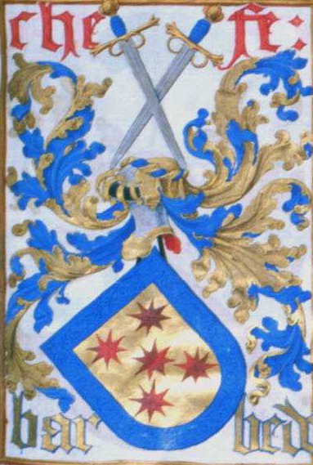
Rules of Heraldry – Blazon
Or,
five mullets of eight points
two, one, and two
gules
within a bordure
azure.
Arms of the Chefe Barbedo (Portugal)

Slide 49
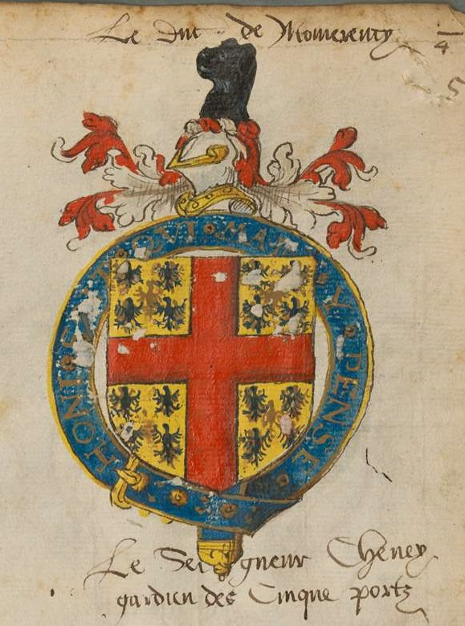
Rules of Heraldry – Blazon
Or
semy of
eagles azure,
a cross gules.
Sir (Thomas) Cheney, Lord Warden of the Cinque Ports
Images from Insignia Anglica, mid 16C
Notes:
No need to say “throughout”, that’s default for crosses.
Semy is one of the few situations where central charge isn’t listed first.

Slide 50
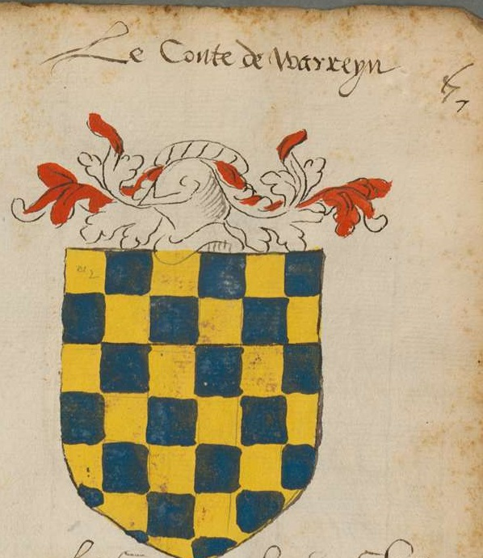
Rules of Heraldry – Blazon
Checky
Or and azure.
Count of Warren
Images from Insignia Anglica, mid 16C
Notes:
Or is listed first since its in dexter chief, though no difference for conflict.
Semy is one of the few situations where central charge isn’t listed first.

Slide 51
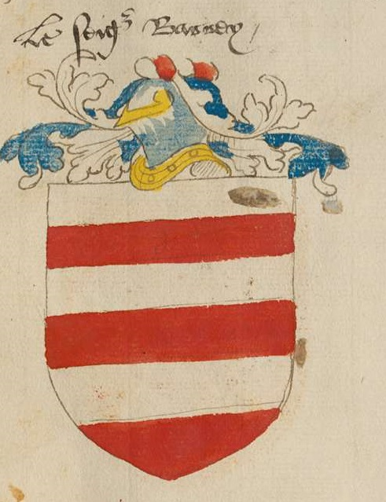
Rules of Heraldry – Blazon
Barry
argent and gules.
Images from Insignia Anglica, mid 16C
Notes:
Even divisions, so barry. Argent to chief, so first.

Slide 52
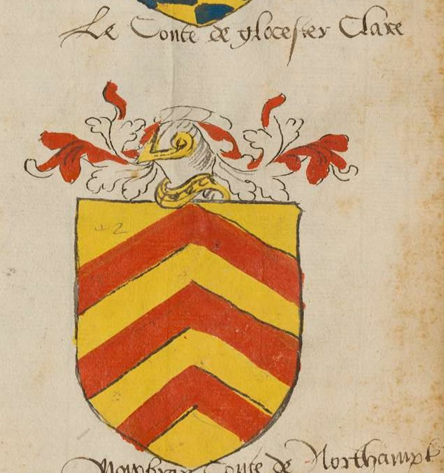
Rules of Heraldry – Blazon
Or,
three chevronels
Gules.
Count of Clare
Images from Insignia Anglica, mid 16C
Notes:
Not chevronelly since unequal number of parts

Slide 53
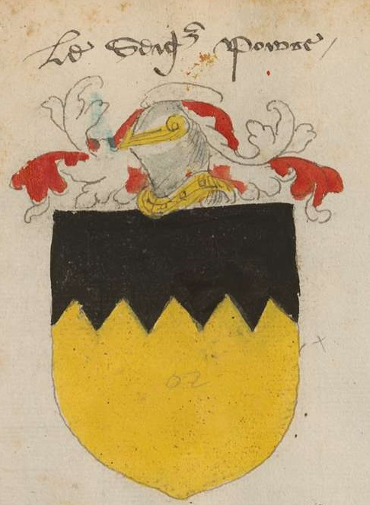
Rules of Heraldry – Blazon
Or,
a chief indented
sable.
Images from Insignia Anglica, mid 16C

Slide 54
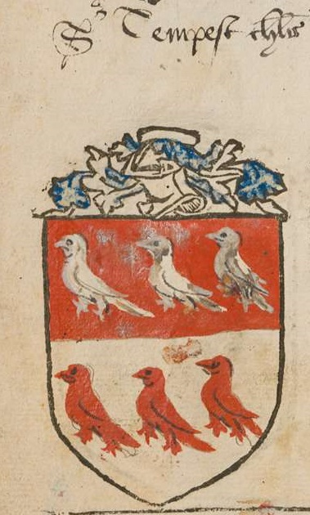
Rules of Heraldry – Blazon
Per fess
gules and argent,
six martlets
three and three
counterchanged.
Images from Insignia Anglica, mid 16C

Slide 55
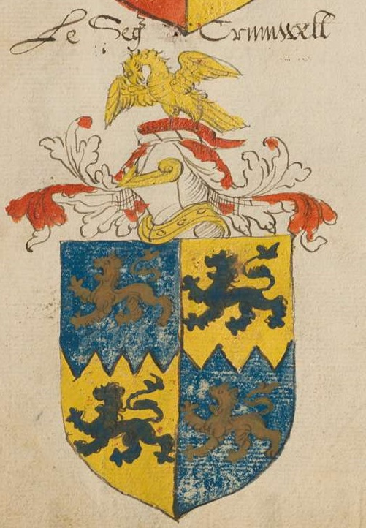
Rules of Heraldry – Blazon
Quarterly
per fess indented azure and Or,
four lions
passant
counterchanged.
Images from Insignia Anglica, mid 16C

Slide 56
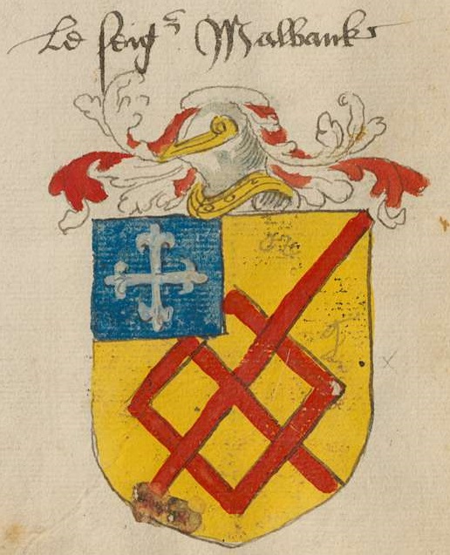
Rules of Heraldry – Blazon
Or,
a fret gules
and on a canton azure
a cross flory argent.
For info on crosses, see: http://coblaith.net/Heraldry/Crosses/
Images from Insignia Anglica, mid 16C

Slide 57
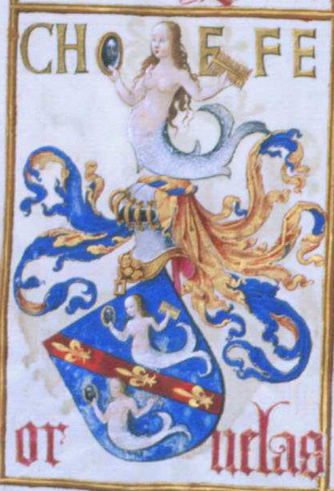
Rules of Heraldry – Blazon
Azure,
on
a bend gules
between two mermaids argent,
three fleurs-de-lys
Or.
Arms of the Chefe Ornelas (Portugal)

Slide 58
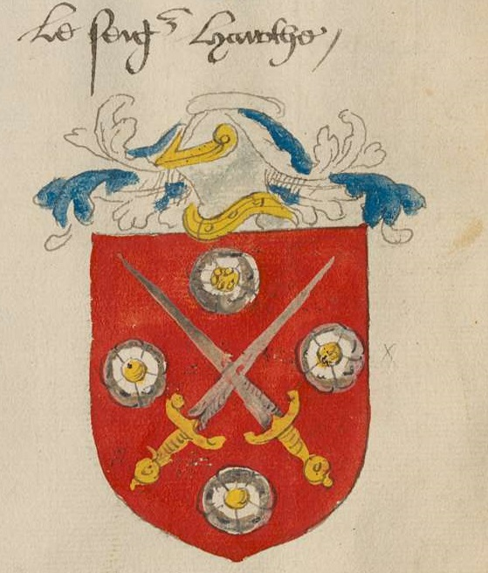
Rules of Heraldry – Blazon
Gules,
two swords
in saltire
proper
between four roses
in cross
argent.
Images from Insignia Anglica, mid 16C

Slide 59
Final Thoughts
Registerable vs. Authentic
A submission must be registerable; it need not be authentic
While we can encourage clients to design period-looking armory, we cannot, and should not, force the decision
If a client is set on a registerable but not very authentic submission, you should process it!

Slide 60
Final Thoughts
Customer Service
It is our job to help our clients
We are here to make registrations happen, not prevent them from happening
When consulting, help clients create registerable submissions they like
When commenting, look for reasons to allow registration, not prohibit it
Heralds want a reputation for being helpful, not obstructionist!

Slide 61
About me
Elmet Herald – I am the East Kingdom heraldic education deputy
elmet@eastkingdom.org
jgalak@gmail.com
This handout can be found at:
http://www.yehudaheraldry.com/ekhu

